Slide 1
HealthBot
Team: Los Blancos
DEV VYAS
GOPAL BHUVA
PRINCE PRAJAPATI
JAYRAJSINH RATHOD

Slide 2
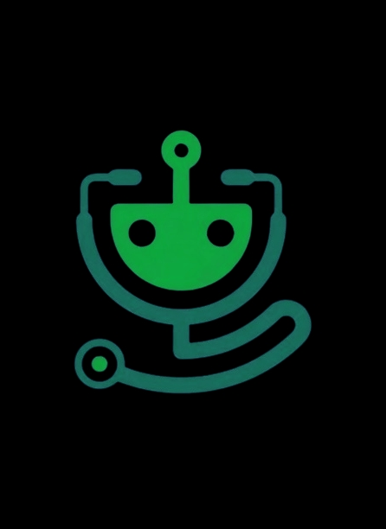
Summary
HealthBot: The HealthBot is a web-based application which has ability to understand the user’s health related issues by the symptoms which user provide, the HealthBot will generate the medications for that particular illness which user is facing.

Slide 3
Functionalities
LOGIN/REGISTER: User have to login or register him/herself before using the bot
ADVANCED FEATURE: User can use advanced functionalities of the bot, such as Fitness Tracker, Nutrition Advice etc.
CHATBOT: User can chat with bot and tell about their health issues to get the medication advice.
LOGOUT: After using the bot user can simply logout from the bot.

Slide 4
Language & Libraries
The HealthBot is made using the Python language.
Streamlit
spaCy
sqlite3
hashlib
PIL (Pillow)
io and base64
os

Slide 5
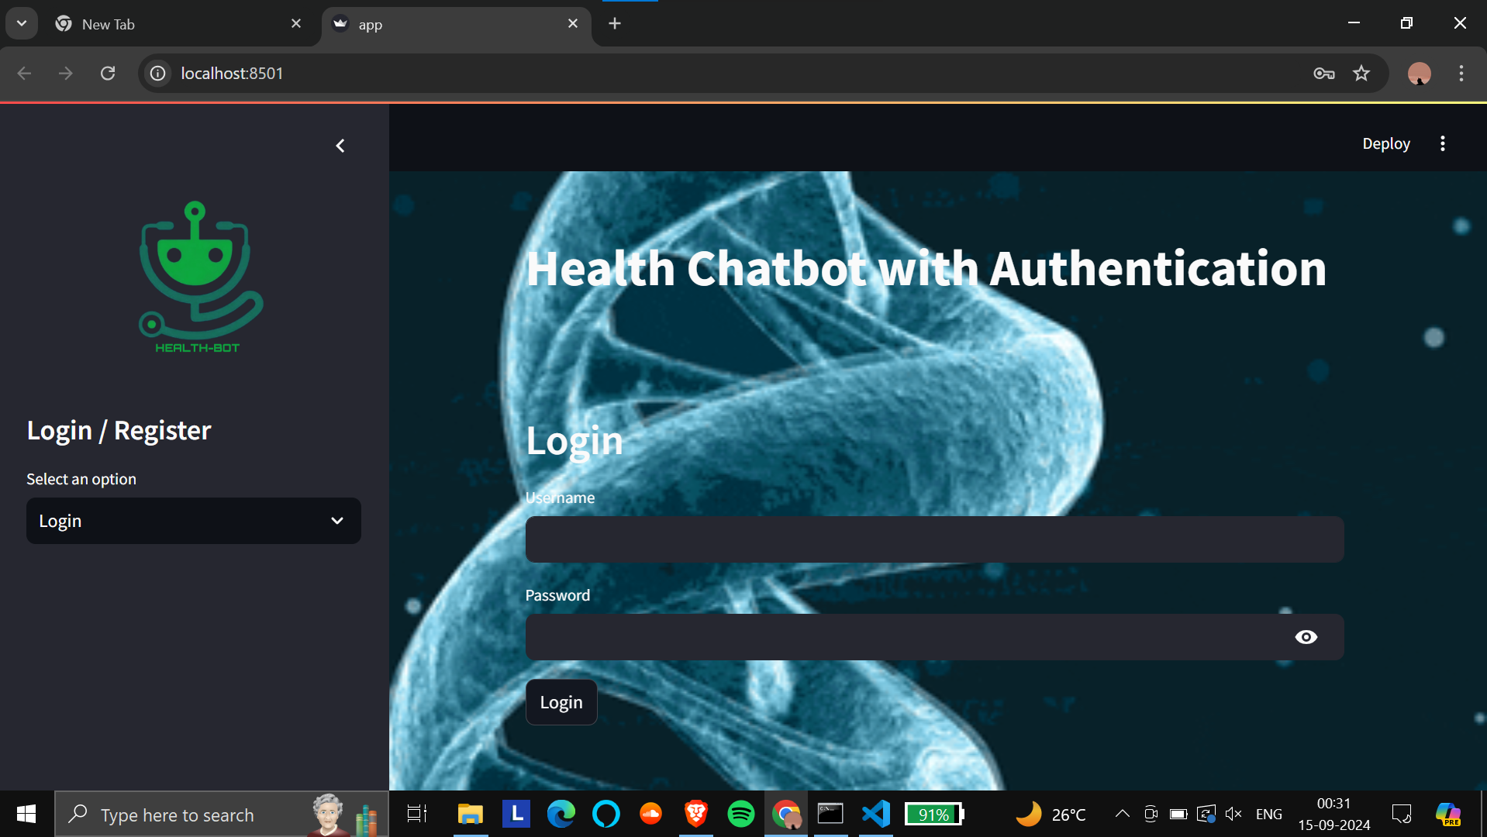
Login Page

Slide 6
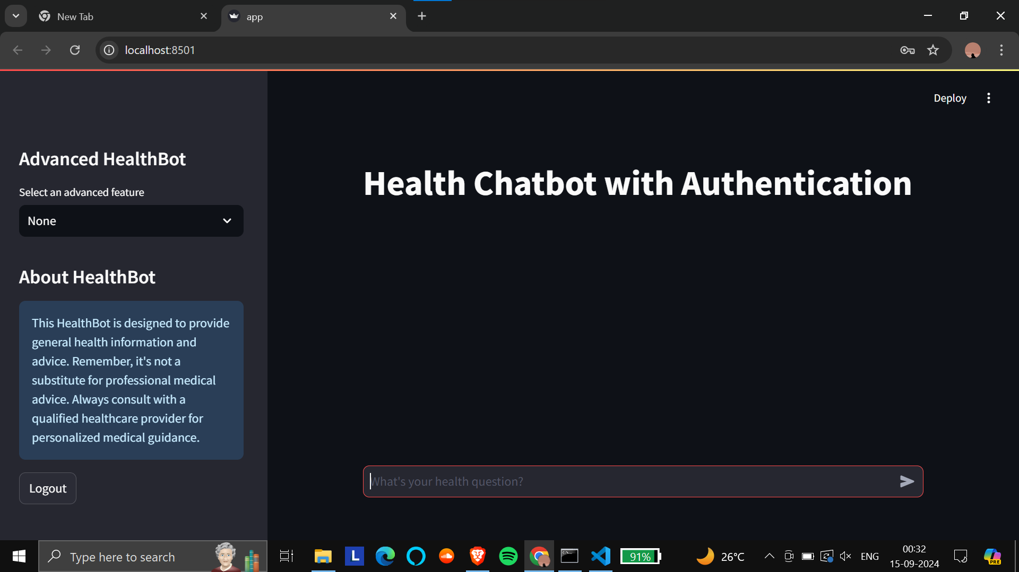
Main Page

Slide 7
Thank You

